Slide 1
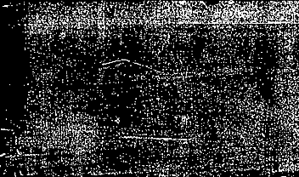

AIEplace
Application Specification

Slide 2
AIEplace Application Overview
Exists and functions.
Partially exists, work-in-progress
Planned, but does not exist yet
Host Code (x86)
PL
AIEs
Partials compute graph
Read LEF, DEF, into DataBase
Partials
MM2S
Key:
MM2S = Memory Map to Stream
(used for sending data to AIEs)
S2MM = Stream to Memory Map
(used for receiving output from AIEs)
Partials
MM2S
Partials compute graph
Initialize placement
Partials
MM2S
Partials compute graph
Placement Iteration
(repeat to convergence)
Partials
S2MM
Send node positions
Partials
S2MM
Receive partials
Partials
S2MM
1D-DCT compute graph
a_{u,v}
Send density data
Density
MM2S
Transpose
1D-IDCT compute graph
Receive computed
E-field
Generate
Visualization
Write output
1D-IDXST compute graph
Density
S2MM

Slide 3

Partials graph -- Dataflow
AIE kernels can have at most 2 input and 2 output streams, so we combine x data with computed a± data into xa stream.
We also combine b± and c± into bc stream.
From PL
abc
kernel
^{xa stream}
kernel
^{x stream}
$$\frac{{∂WL}_{n}}{{∂x}_{i}}$$
All coordinates on net n
^{bc stream}
Return to PL
^{partials stream}
Partials graph
Alternative approaches:
Use buffers instead of streams
Variable amount of memory needed depending on net size
Combine kernels into one single kernel
Divide abc kernel into different kernels
Might cause more problems than it solves
Full application fills AIE array with many partial graphs.

Slide 4


Partials Graph -- Stream Format
Example for net_size = 5
Sorted X data: | X₄ _{(min value)} | X₃ | X₂ | X₁ | X₀ _{(max value)}
Stream dataflow direction
Max and min values for each net are sent first to allow computing of:
Stream “x_in” | X₃ | X₂ | X₁ | X₄ _{(min value)} | X₀ _{(max value)}
$$a^{+}= e^{\frac{\left(x_{i}−x_{max}\right)}{γ}}$$
$$a^{−}= e^{\frac{\left(x_{min}−x_{i}\right)}{γ}}$$
Stream “xa” | a₃⁻ | a₃⁺ | X₃ | … | a₄⁻ | a₄⁺ | X₄ | a₀⁻ | a₀⁺ | X₀
Stream “bc” |  | c⁻ | b⁻ | c⁺ | b⁺
Stream “partials” | ∂₄ | ∂₃ | ∂₂ | ∂₁ | ∂₀
Note: This example illustrates the data order for a single net. To leverage the AIE vectorization, XY data groups of 4 nets are processed at the same time, described on the next slide.

Slide 5
Partials Graph -- net Groups
Addr offset | 0 | 1 | 2 | 3 | 4 | 5 | 6 | 7
 | net_0 | net_0 | net_1 | net_1 | net_2 | net_2 | net_3 | net_3
0x00 | node0 X | node0 Y | node0 X | node0 Y | node0 X | node0 Y | node0 X | node0 Y
0x08 | node1 X | node1 Y | node1 X | node1 Y | node1 X | node1 Y | node1 X | node1 Y
0x10 | node2 X | node2 Y | node2 X | node2 Y | node2 X | node2 Y | node2 X | node2 Y
0x18 | node3 X | node3 Y | node3 X | node3 Y | node3 X | node3 Y | node3 X | node3 Y
0x20 | node4 X | node4 Y | node4 X | node4 Y | node4 X | node4 Y | node4 X | node4 Y
Max value on net
Min value on net
This table illustrates a single “group” of nets with size = 5
Data parallelism: Vectorized AIE kernel to operates on 8 coordinates.
This is the format expected by the AI Engine “abc_kernel”
These XY values are floats. TODO: try integer data type.

Slide 6
Codebase
Important dataflow functions to know about:
DataBase::initializePacketContents()
DataBase::prepareNetGroup()
DataBase::storeNetGroup()
GraphDriver::send_packet()
GraphDriver::receive_packet()

Slide 7
Database::initializePacketContents()
This function organizes net “groups” of node coordinates into “packets”
Generate packets for all nets of size 2 thru 8.
Run once to initialize the data order.
A “group” is X and Y data of 4 nets of the same size, which enables vectorization
A packet is a set of groups.
The number of groups_per_packet = 840 / net_size
840 is LCM of sizes 2-8, which means all nets <= 8 will fit neatly into 840
also fits nets size 10, 12, 14, 15, 20, 24, 42…
In “Common.h”:
Could bigger or smaller packets improve performance?
For nets with size greater than 8, need a more generic kernel handling
Or, just handle large nets in code. Most nets are size 2 thru 8.
constexpr int NETS_PER_GROUP = 4;
constexpr int LCM_BUFFSIZE = 840;

Slide 8
DataBase::prepareNetGroup()
Load coordinate data specified by database into packets.
DataBase::storeNetGroup()
Received data from AIE processing must be placed back into memory correctly.
GraphDriver::send_packet()
GraphDriver::receive_packet()
Performs the xrt API commands to send or receive full data packet transfer

Slide 9

Codebase Dataflow
Setup
DataBase::readDEF()
DataBase:: initializePacketContents()
DataBase:: prepareNetGroup()
GraphDriver:: send_packet()
Iteration Coordinate update
Partials graph
abc
kernel
^{xa stream}
kernel
$$\frac{{∂WL}_{n}}{{∂x}_{i}}$$
^{bc stream}
GraphDriver:: receive_packet()
DataBase:: storeNetGroup()

Slide 10







Density graph FlowChart
2D-IDCT
$$ψ$$
$$"electric potential"$$
Density
IDCT
IDXST
$$ξ_{X}$$
2D-DCT
$$a_uv$$
$$ρ$$
$$"electric field"$$
IDXST
IDCT
$$ξ_{Y}$$
2D-DCT
DCT
(AIE)
Transpose
(PL)
DCT
(AIE)
Transpose
(PL)
DCT
Shuffle
(PL or AIE)
FFT
(AIE)
Post-processing
(PL or AIE)

Slide 11
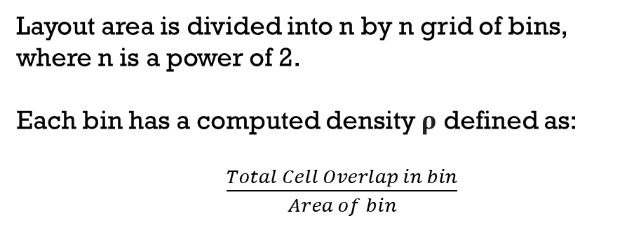
Density graph -- data movement
For final application, n is 512 or 1024.
Layout area is divided into n by n grid of bins, where n is a power of 2.
Each bin has a computed density ρ defined as:
$\frac{Total Cell Overlap in bin}{Area of bin}$
ρ_0_0 | ρ_0_1 | ρ_0_2 | ρ_0_3 | … | ρ_0_n
ρ_1_0 | ρ_1_1 | ρ_1_2 | ρ_1_3 | … | ρ_1_n
ρ_2_0 | ρ_2_1 | ρ_2_2 | ρ_2_3 | … | ρ_2_n
ρ_3_0 | ρ_3_1 | ρ_3_2 | ρ_3_3 | … | ρ_3_n
… | … | … | … | … | …
ρ_n_0 | ρ_n_1 | ρ_n_2 | ρ_n_3 | … | ρ_n_n
To compute electric field:
Each row is sent as a “packet” of fixed size n to the AIE graph which computes 1D-DCT.
After each row has been processed, a transpose is performed in PL, and then rows are sent for another 1D-DCT. (This is equivalent to performing DCT on the columns.)
Another transpose completes the 2D-DCT, and we have computed term a_{u,v}
We repeat for IDCT and IDXST functions as shown on previous slide to obtain the X and Y electric field terms in each bin.

Slide 12
Archive

Slide 13
Partials graph detail (variant)
From PL
x_{i}
a±
kernel
b± and c± kernel
All coordinates on net n
a±
b±, c±
∂WL_{n} / ∂x_{i}
kernel
HPWL
kernel
Return to PL

Slide 14
Data packets
Buffers used for data transfer need to be of fixed size.
Problem: need to transfer nets of varied size.
Solution: Set packet size to 840 vectors, the LCM of net sizes 2 thru 8.
For net size of 5, a full packet would contain 840 / 5 = 168 groups.
This packet would contain XY data for 168 * 4 = 672 nets of size 5.

